Slide 1
VLAN
Dr.Mohammed Abdalla Mahmoud Youssif
1

Slide 2

2
Notes:
2

Slide 3
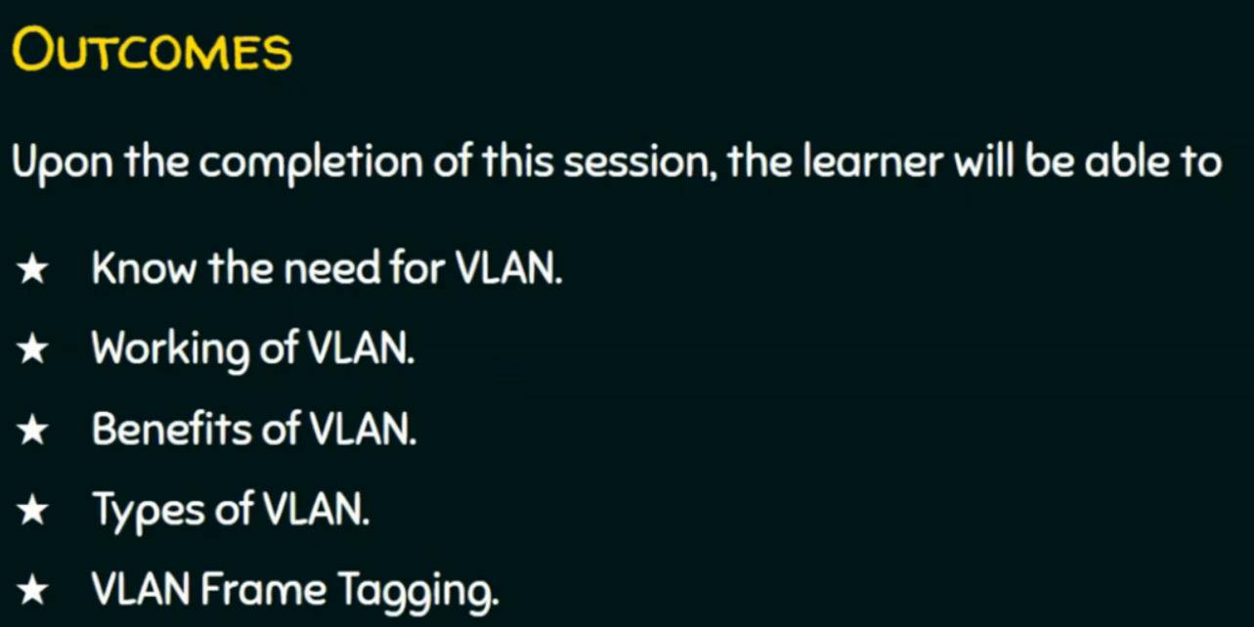
3
Notes:
3

Slide 4
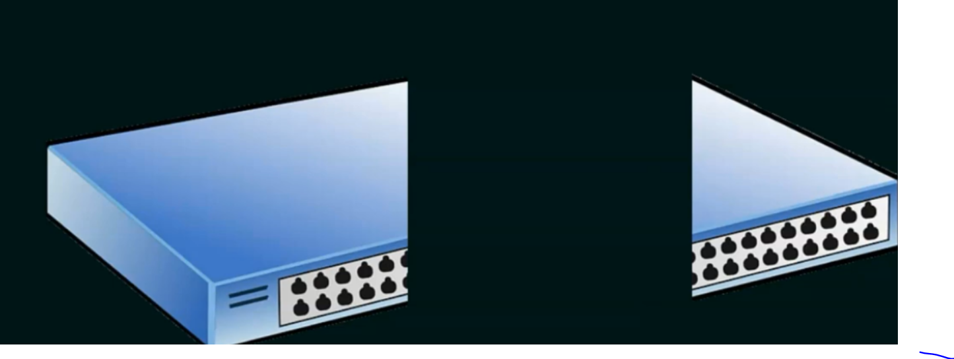
4
Notes:
- suppose breaking the switch into two pieces : one for local area network and the other part for another area network.
-This is can not be done physically (Partioning).
- Logical portioning can be done by VLAN.
4

Slide 5
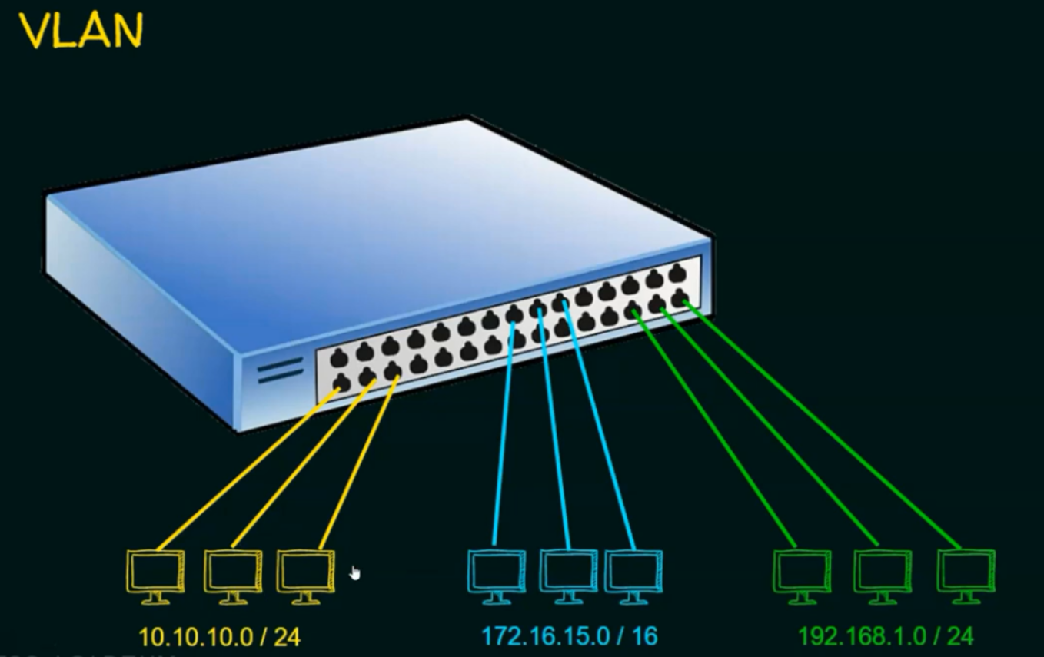
5
Notes:
- 3 VLANs : yellow VLAN, blue VLAN, and green VLAN
- every VLAN has its own Ips.
Suppose PC1 10.10.10.1 in yellow VLAN send a broadcast, only PCs in yellow VLAN will receive the message.
Every VLAN has a different IP schema.
5

Slide 6
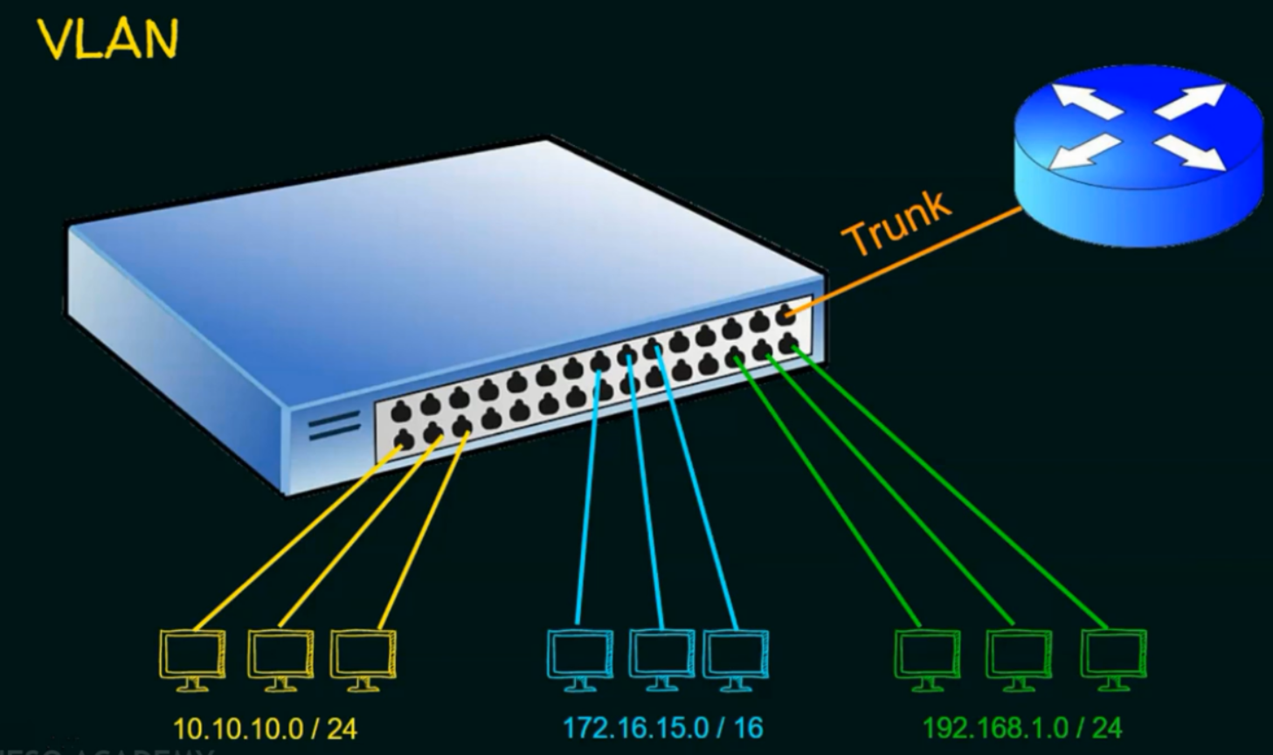
6
Notes:
- this is port is called Trunk port. Between switch and router that holds all traffic from 3 VLANs.
If VLAN1 needs to send data to VLAN2 , this is can be achieved Via router.
Different networks can communicate with each other Via router.
6

Slide 7
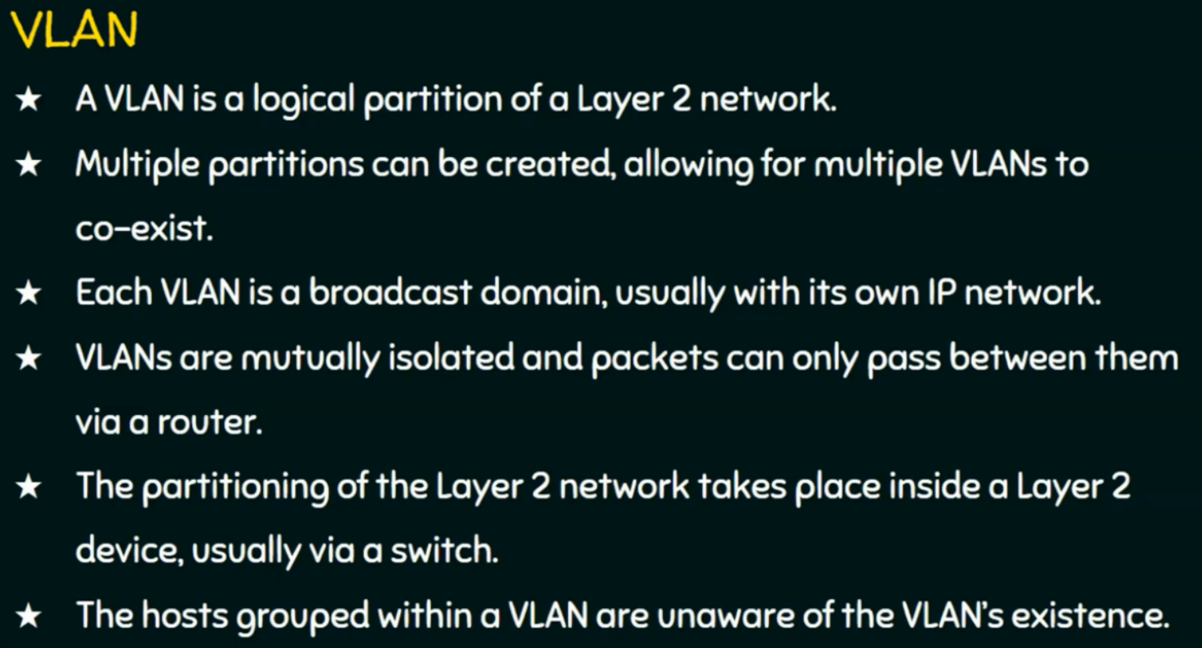
7
Notes:
-
7

Slide 8
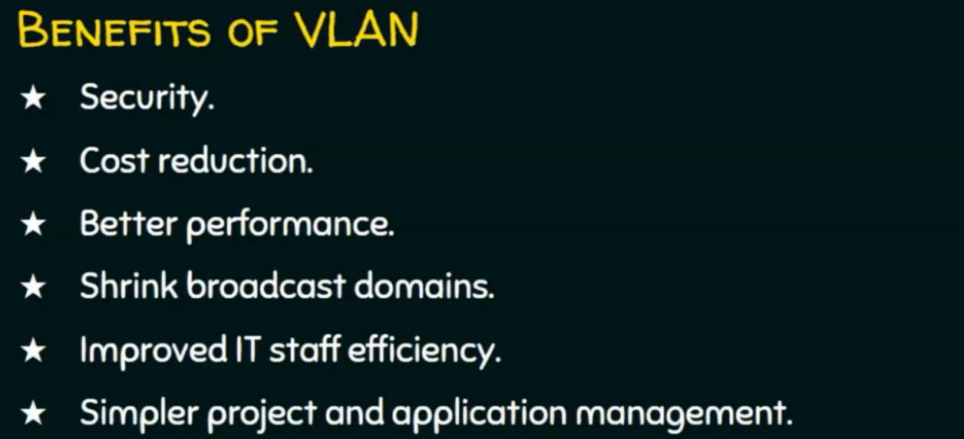
8
Notes:
- Security : because the broadcast messages of VLAN can not be sent to another VLAN.
Cost Reduction: instead of multiple switch devices.
Better performance: maximize utilization of the resources (Switch).
8

Slide 9
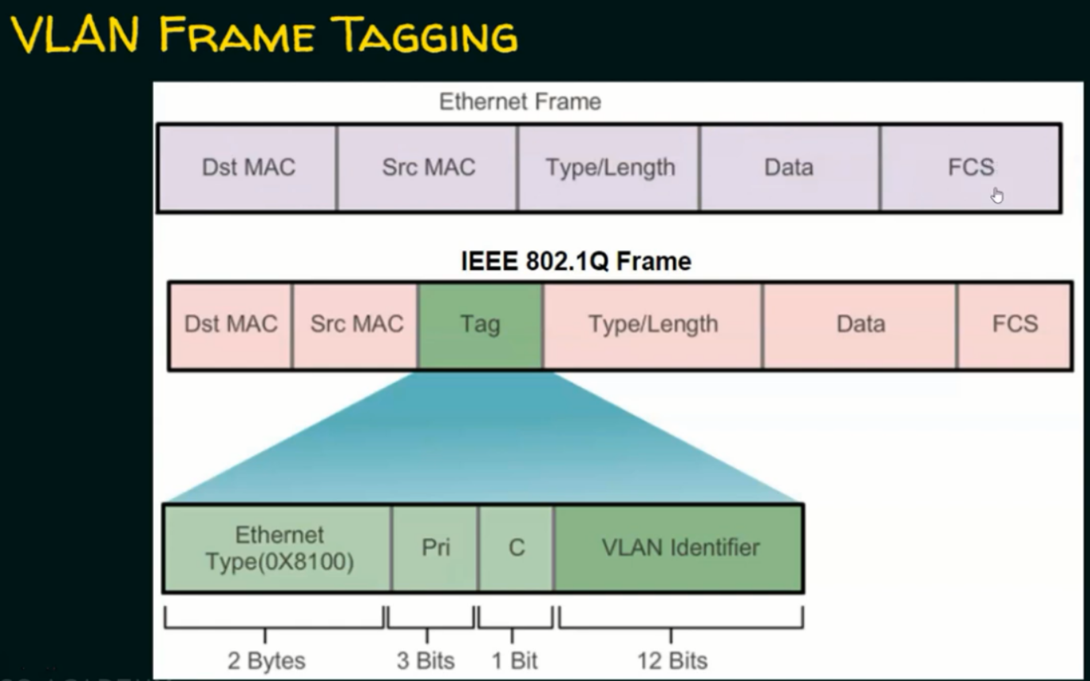
9
Notes:
- Dst Mac: destination mac address.
- Src mac: source mac address.
FCS: frame checksum sequence for error detection.
Tag is responsible for identifying the VLAN.
Pri : piriorty.
9

Slide 10
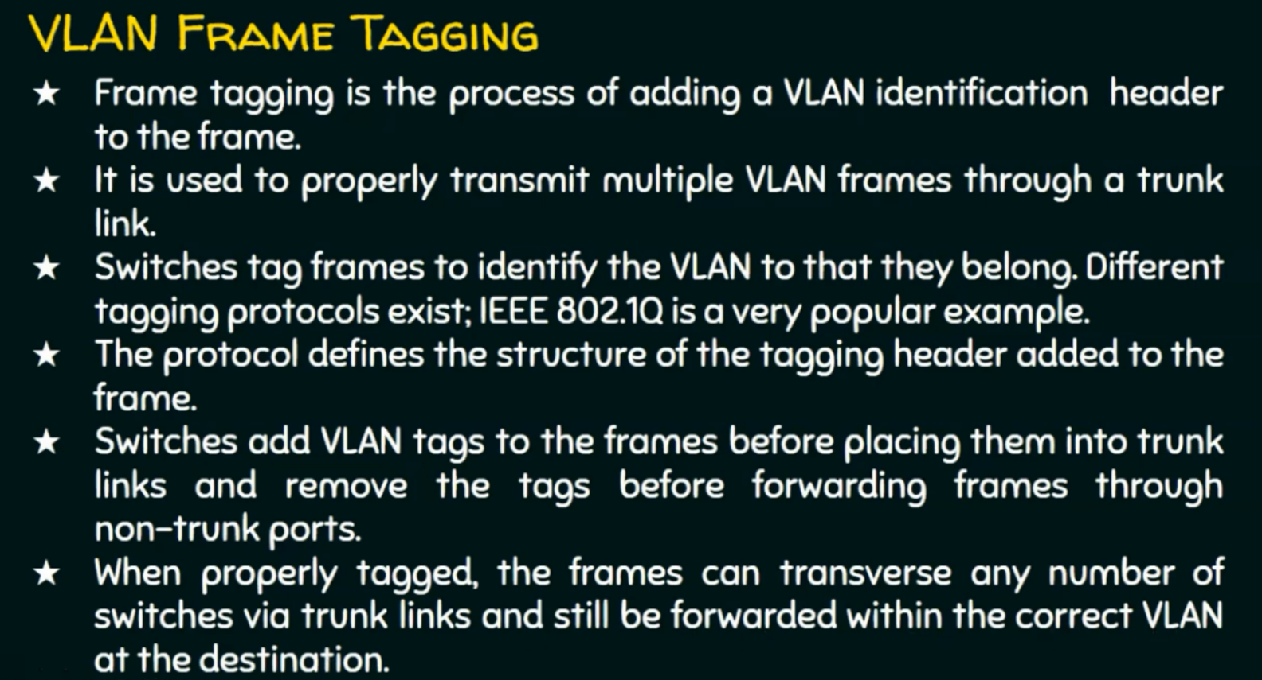
10
Notes:
10

Slide 11
Questions ?
11
Notes:
11

Slide 12

12
Notes:
12

